Slide 1
Simulated Annealing
By Rohit Ray
ESE 251

Slide 2
The Problem
Most minimization (maximization) strategies work to find the nearest local minimum
Trapped at local minimums (maxima)
Standard strategy
Generate trial point based on current estimates
Evaluate function at proposed location
Accept new value if it improves solution

Slide 3
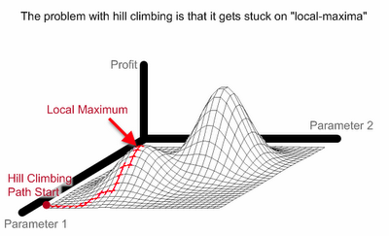
Example: Hill Climbing
Look around at states in the local neighborhood and choose the one with the best value
Taken from www.maxdama.com

Slide 4
Solution
A new strategy must be developed to discover other minimum
This involves evaluating a functions at points that don’t necessarily improve the solution

Slide 5
Simulated Annealing
Inspired from ancient process of forging iron
Annealing refers to the fast heating of a metal and then cooling it slowly
The method was first proposed by Metropolis (1953)
Monte-Carlo methods
P=(-∆E/kT)
Kirkpatrick et al. (1982) later improved the SA method applied optimization problems

Slide 6
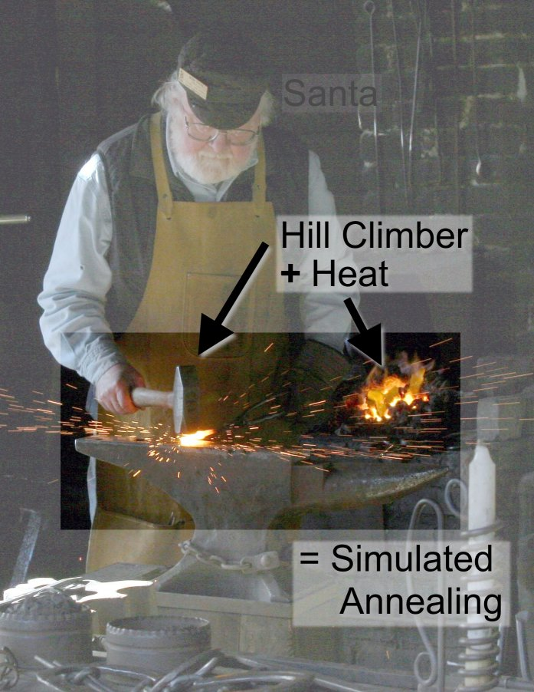
Simulated Annealing
Taken from www.maxdama.com

Slide 7
Simulated Annealing
High temperature→ High Disorder → High Energy
SA differs from hill climbing in that a move is selected at random and then decides whether to accept it
In SA better moves are always accepted. Worse moves are not

Slide 8
Simulated Annealing
The probability of accepting a worse state is a function of both the temperature of the system and the change in the cost function
As the temperature decreases, the probability of accepting worse moves decreases
If T=0, no worse moves are accepted (i.e. hill climbing)

Slide 9
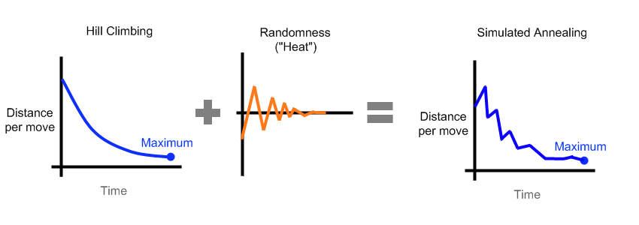
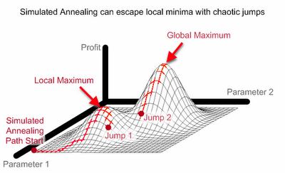
Simulated Annealing
Taken from www.maxdama.com

Slide 10
SA: Starting Temperature
Must be hot enough to allow moves to almost every neighborhood state
Must not be so hot that we conduct a random search for a long period of time
Problem is finding a suitable starting temperature

Slide 11
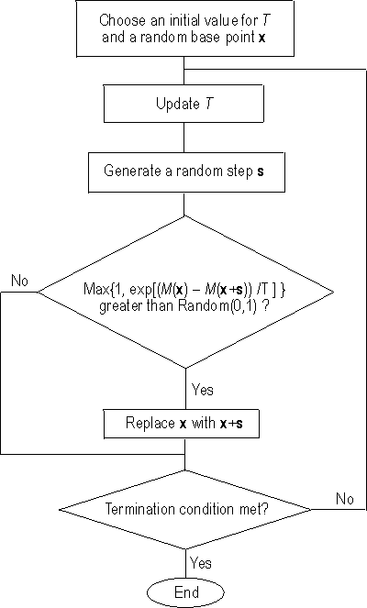
SA Algorithm

Slide 12
Matlab: Built –In Function
Genetic Algorithm and Direct Search Toolbox
SIMULANNEALBND Bound constrained optimization using simulated annealing.
SIMULANNEALBND attempts to solve problems of the form:
min F(X) subject to LB <= X <= UB
Taken from www.mathworks.com

Slide 13
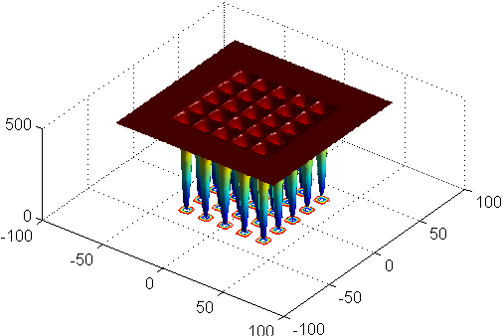
Matlab Ex: Minimization of De Jong's fifth function

Slide 14
Matlab Example
x0 = [0 0]; [x,fval] = simulannealbnd(@dejong5fcn,x0)
x = 0.0392 -31.9700
fval = 2.9821
Taken from www.mathworks.com

Slide 15
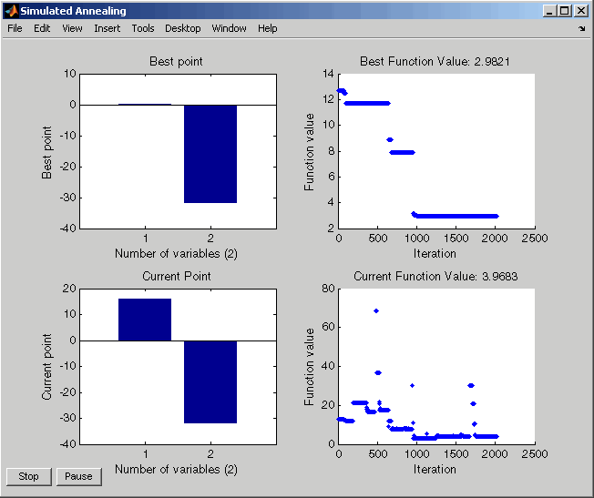
Matlab: Built-In Function Results
Taken from www.mathworks.com

Slide 16



My Matlab code
Application of stochastic algorithms for parameter estimation in the liquid–liquid phase equilibrium modeling by Ferrari et al;
Used to find parameters for Non-Random Two Liquid model (NRTL)
Useful for generating ternary diagrams

Slide 17
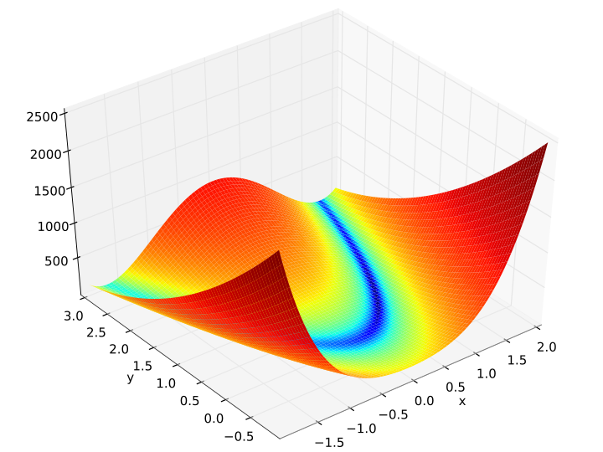
Tests of My Code
Rosenbrock
Known Global Minima at (1,1) with function value 0
Successfully found every time

Slide 18
SA Advantages/Disadvantages
Advantages
Guaranteed to find optimum
Avoids being trapped at local minimums
Disadvantages
No time constraints
Not faster than many contemporaries

Slide 19
Works Cited
www.sph.umich.edu/csg/abecasis/class/2006/615.19.pdf
http://www.maxdama.com/2008/07/trading-optimization-simulated.html
www.intelligentmodelling.org.uk
www.mathworks.com

Slide 20
The End

